Slide 1


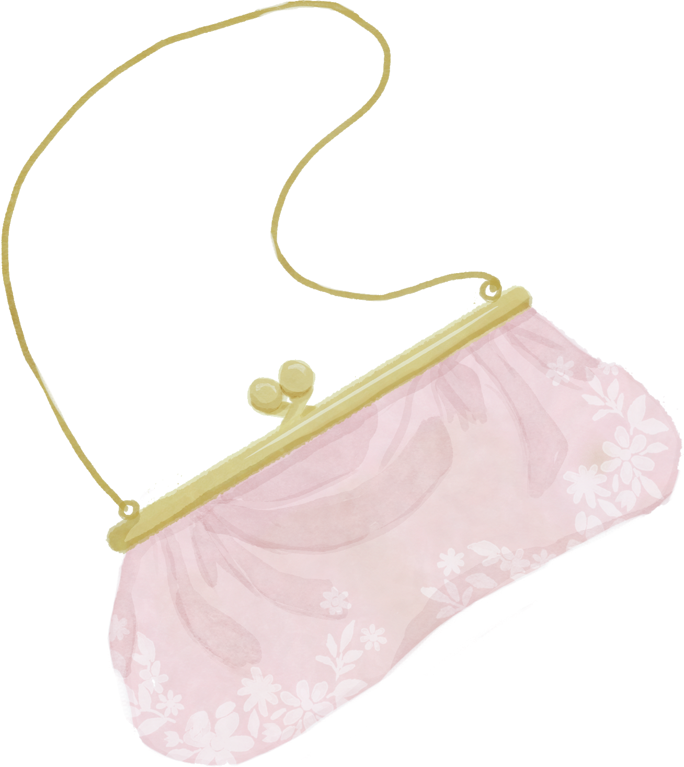

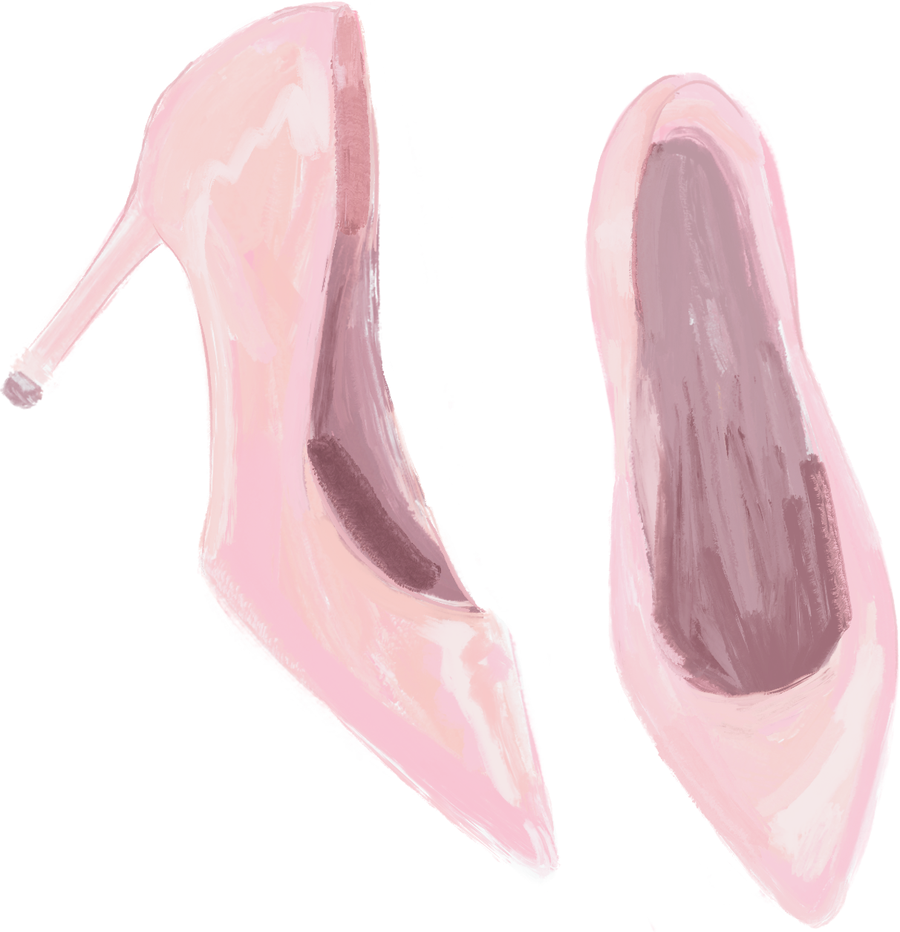
WELCOME TO
Olivia's
BRIDAL SHOWER

